Slide 1
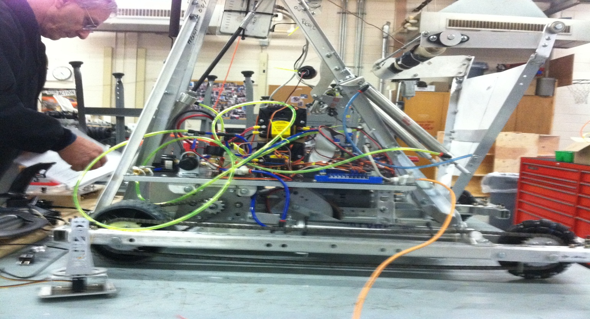
Power Transmission & Drivetrain

Slide 2
Creating Effective Robot Mechanisms
Drivetrain: Moves Quickly Has Good Pushing Power (Power & Traction) Turns Easily Good Control
Manipulation: Picks up, Moves or Throws Game Pieces Consistently
Motors do not Overheat, Breakers do not Trip

Slide 3
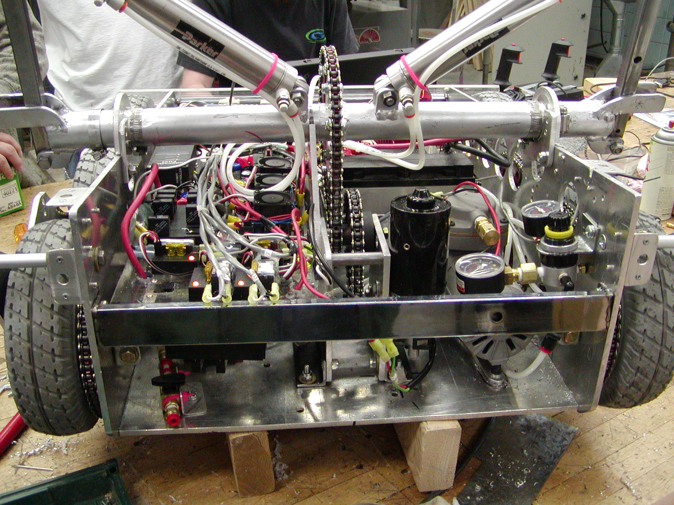

Slide 4
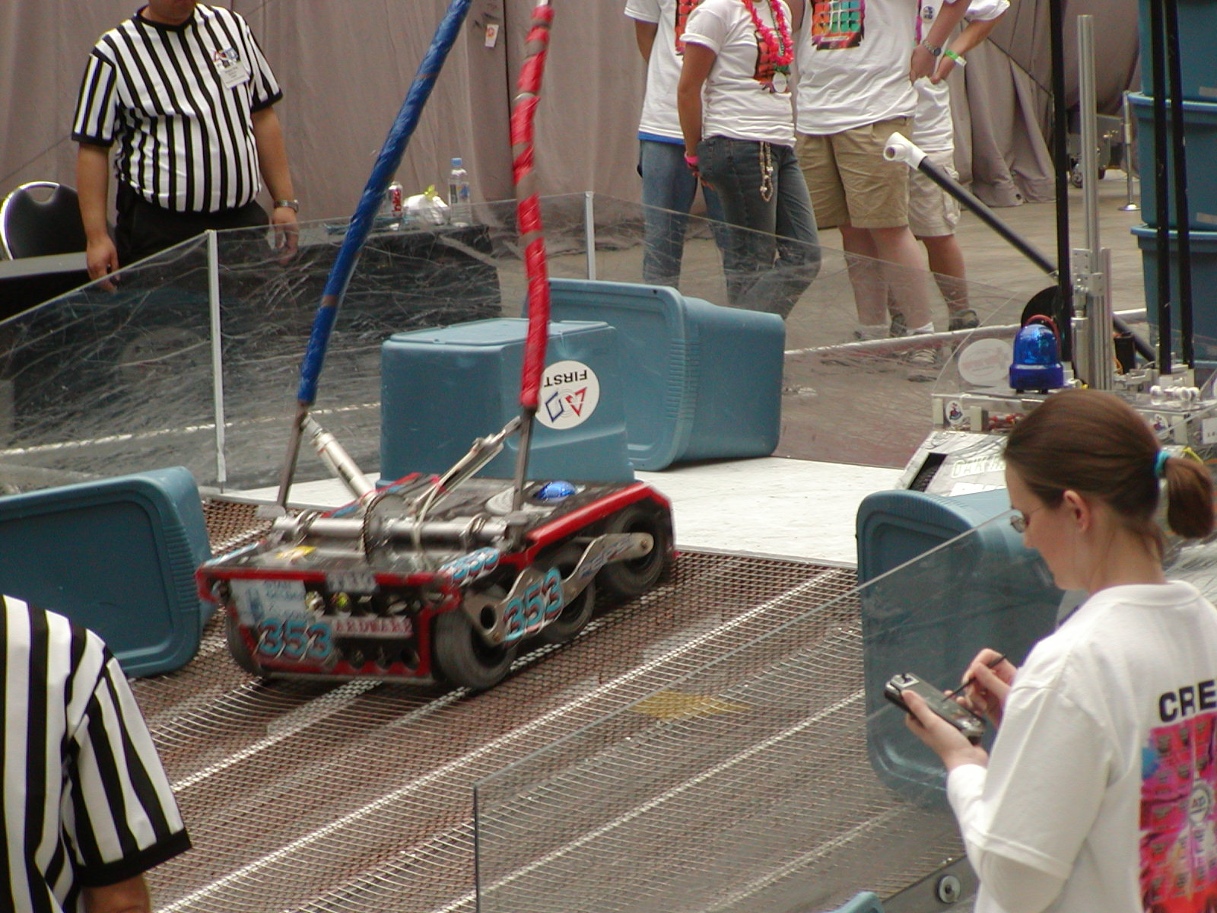

Slide 5
Power Transmission & Drivetrain
Basic Drive Train
Two Wheel Drive With Casters
Notes:
Advantages? Disadvantages? Integrate wheel rotation sensors with any drive train! Helps especially during autonomous mode

Slide 6
Power Transmission & Drivetrain
Basic Drive Train
Two Wheel Drive
All Traction Wheels
Notes:
Advantages? Disadvantages?

Slide 7
Power Transmission & Drivetrain
Basic Drive Train
Two Wheel Drive
Omniwheels on one Axle
Notes:
Advantages? Disadvantages?

Slide 8
Power Transmission & Drivetrain
Basic Drive Train
Four Wheel Drive
All Traction Wheels
Notes:
Advantages? Disadvantages?

Slide 9
Power Transmission & Drivetrain
Basic Drive Train
Four Wheel Drive
Omniwheels on one Axle
Notes:
Advantages? Disadvantages?

Slide 10
Power Transmission & Drivetrain
Drive Train
Six Wheel Drive
Notes:
Advantages? Disadvantages? Note center wheels slightly lower. Why? Climbing?

Slide 11
Power Transmission & Drivetrain
Drive Train
Option:
Motor mounted shaft down with bevel gear drive
Four wheel Drive Super Traction Wheels All Wheels Steer
Turning Mode
Notes:
Advantages? Disadvantages Steering control can be done with chains, belts or steering motors and sensors

Slide 12
Power Transmission & Drivetrain
Drive Train
Option:
Motor mounted shaft down with bevel gear drive
Four wheel Drive Super Traction Wheels All Wheels Steer
Side Move Mode
Notes:
Advantages? Disadvantages?

Slide 13
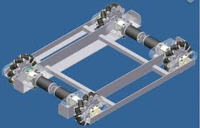
Power Transmission & Drivetrain
Mecanum Drive Train

Slide 14
Power Transmission Possibilities
Transfer Power to another place
Reverse Direction of Input
Change Direction of Input
Change Motion Type
Increase Speed and Distance while decreasing torque
Decrease Speed and Distance while increasing torque

Slide 15
Power Transmission Elements Levers
Class 1
Class 2
Class 3
Input
Output
Fulcrum
Input
Output
Output
Input
Fulcrum
Give me a lever long enough and a fulcrum on which to place it, and I shall move the world.
Archimedes
Fulcrum

Slide 16
Power Transmission Elements Levers in Action
Output
25 Lbs out
8” Stroke
Input
50 Lbs Applied
4” Stroke
Pneumatic Piston
Note: connecting elements should be perpendicular at mid stroke!
Fulcrum
What class Lever?
Notes:
What Class Lever?

Slide 17
Power Transmission Elements Levers in Action
Fulcrum
100 Lbs out
2” Stroke
Output
Note: connecting elements should be perpendicular at mid stroke!
50 Lbs Applied
4” Stroke
Input
Pneumatic Piston
Do Levers need to be Straight?
What class Lever?
Notes:
What Class Lever?

Slide 18
Power Transmission Elements
Chains & Belts
Output
Input
Notes:
Rotational Direction of Input and Output?

Slide 19
Power Transmission Elements
Friction Drive
Gear Drive
Output
Input
Notes:
Rotational Direction of Input and Output?

Slide 20
Power Transmission Elements
Rotary Motion To Linear
Input
Rack & Pinion
Notes:
Rotational Direction of Input and Output?

Slide 21
Power Transmission Elements
Rotary Motion To Linear
Fulcrum
Input
Ouput
Notes:
Rotational Direction of Input and Output?

Slide 22
Power Transmission Elements
Calculating Ratios of a Powertrain
Output
Input
2 inches D
or
20 Teeth
3000 RPM
100 in/oz
6 inches D
or
60 Teeth
Input element size
2
6
= Speed(RPM) & Distance Ratio
= .33 X 3000 = 1000 RPM out
Output element size
Output element size
6
2
= Torque & Force Ratio
= 3 X 100 = 300 in/oz out
Input element size
Notes:
Rotational Direction of Input and Output?

Slide 23
Power Transmission Elements
Calculating Ratios of a Powertrain
Output
6 inches D
Input
2 inches D
or
20 Teeth
3000 RPM
100 in/oz
4” D
1” D
More than one ratio in a system? Multiply the individual ratios to find the overall ratio
2
6
1
4
= .0825 Speed Ratio X 3000 RPM= 247 RPM out
X
6
2
4
1
= 12 Torque Ratio X 100 in/oz= 1200 in/oz out
X

Slide 24
Important Terms
Power Transmission Elements
Torque- The twisting or rotational force of a shaft (Driver or Driven)
Measured as a force applied a defined distance from the center of rotation
Examples:
Foot pound, Inch pound, inch ounce, newton meter
1 Foot Pound
Distance 12 inches
Center of Rotation
Force 1 pound

Slide 25
Important Terms
Power Transmission Elements
RPM’s –Revolutions per minute
The Angular Velocity of an object- How fast is it turning?
Note: The CIM motor used for drive power on most robots turns at a about 5000 RPMs unloaded

Slide 26
Important Terms
Power Transmission Elements
Power –(Horsepower) ability to do work
Always must include a force, a distance, and time
1 horsepower= lift 550 pounds one foot in one second
1 horsepower= 746 watts
Note: The Cim motor power ratings :
Voltage: 12 volt DC
No load RPM: 5,310 (+/- 10%)
Free Current: 2.7 amps
and 68 amps)
Stall Torque: 2.42 N-m, or 343.4 oz-in
Stall Current: 133 amps
Maximum Power: 337 Watts (at 2655 rpm, 172 oz-in)

Slide 27
Power Transmission Elements
What You Need to Know
When Designing
1-Amount of load that needs to be moved? (Force)
2-How fast does it need to be moved ?(Time)
3- How far does it need to go? (Distance)
If this looks familiar, it is the power requirement of the task!
Notes:
Rotational Direction of Input and Output?

Slide 28
Power Transmission Elements
Common Mistake
Connecting a motor or piston to a mechanism without calculating the output force, distance and speed.
This has happened-more than once!
A CIM motor connected directly to a 6” Diameter Wheel
Speed of bot at 2655 CIM RPM --- 69 feet per second (FPS)
(Most bots have a maximum velocity of 10 FPS. Faster makes for a hard to control robot)
Load applied to ground at CIM 172 in/oz----2 pounds of force
(To drive a 130 pound robot)
Result-Bot does not move, breakers trip, magic white smoke?
Notes:
Rotational Direction of Input and Output?

Slide 29
Power Transmission Elements
Fisher-Price Gear Box Analysis
Input
R 550 motor
17,250 RPM .83 in/oz torque
Output
62
71
38
79
19
12
25
19
Wheel
Notes:
Rotational Direction of Input and Output?

Slide 30
Power Transmission Elements
Fisher-Price Gear Box Analysis
RPM (speed)
Input
R 550 motor
17,250 RPM .83 in/oz torque
62
71
38
79
19
12
25
19
Output
Speed Ratio
6” Wheel
19
71
25
79
19
62
12
38
X
X
X
=
.008
.008
X
17,200RPM
=
140 RPM Output
X 18” Wheel C = 2537 IPM /12=211fpm/60= 3.5 fps
Notes:
Rotational Direction of Input and Output?

Slide 31
Power Transmission Elements
Fisher-Price Gear Box Analysis
Torque
Input
R 550 motor
17,250 RPM .83 in/oz torque
62
71
38
79
19
12
25
19
Output
Torque Ratio
6”D Wheel
71
19
79
25
62
19
38
12
X
X
X
=
122
122
X
.83 in/oz
=
101 in oz output torque
/ 3” radius of wheel
34 oz at ground
=
Notes:
Note at stall (0 RPM) motor torque is 70 in/oz

Slide 32
Power Transmission Elements
Summary
Identify and research your available motors
Google search to find rated RPM and Torque, as well as power draw(Amps)
Design your mechanisms carefully
Calculate ratios and output distance, force applied, and time to actuate
NOTE: Match time is two minutes! A slow mechanism will reduce your performance
Always plan for adjustability. Adding extra fulcrum, input , and output attachment points is easier at the time initial manufacture
Always use double shear attachments when possible. They are much stronger and greatly improve the function of the mechanism
Single Shear
Double Shear
Notes:
Note at stall (0 RPM) motor torque is 70 in/oz

